Slide 1
Using Low-cost Stepper Motors
To Create a Dobby Mechanism

Slide 2
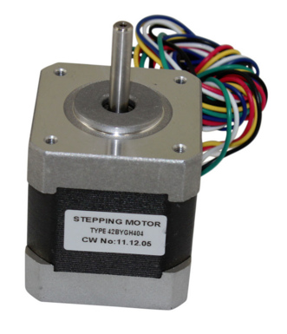
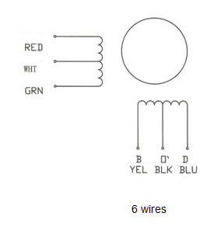
Stepper motor requirements – Loom :
Weight to lift-
Weight of 8 shafts:
2.6 Kg (raw weight)
~5 Kg (with warp tension)
Per Shaft @ 8 shafts ~0.6 Kg per shaft
Lever arm to lift weight-
5 mm shaft on motor (5/16”)
1 mm cord diameter
~8 mm shaft diameter (with tape)
Lever arm ~ 5 mm = 0.5 cm
Approximate torque requirement:
Torque = 0.6 Kg * 0.5 cm = 0.3 Kg-cm (lifting power)
Motors:
characterized by “Holding Torque”, not dynamic lifting power
Maximum rotational speed not specified
Nominal motor de-rating factor: x10 = ~3 Kg-cm (30Ncm)
Price consideration: Nominal $100 for project, $50 for 10 motors, ~ $5 - $8 per motor
Search for Stepper motors:
NEMA 17 (NEMA 23?) footprint
Over 3 Kg-cm torque
6 wire (to simplify control electronics)
Less than .5 Amp per phase @ 12VDC
Vertical view
Motor
1.75” square
4” x 26.75” base
0.42” spacing between shafts
(8 shafts / 3”)
Shaft
6 Wire Motors (12V to ground switching):
ULN2003A Darlington drivers (7 channel )
.5A/channel
$0.51 per part
8 motors * 4 channels per = 32 driver channels
32/7 = 5 ULN2003A packages ($3.57)
Type 42BYGH404 (NEMA 17 footprint)
1.65” x 1.65” x 1.57”
(42.4x42.3x72 cm)
3.4 kg-cm (47.2 oz-in)
.4A per phase
~ $6 per (Summer of 2018)
https://www.circuitspecialists.com/nema_17_stepper_motor_42bygh404.html?otaid=gpl&gclid=Cj0KCQjwjrvpBRC0ARIsAFrFuV8v7XcrsvspC-rLUqVF1CWTetYBij41v3zOubxWgQV1JUICdI5XC2QaAiWJEALw_wcB
4 Wire Motors (full voltage reversal):
L293d 4 channel drivers.6 A/channel
$3.91 per part
8 motors * 4 channels per = 32 driver channels
32/4 = 8 L293d packages ($31.28)
Blk & Wht to +12
Red/grn yel/blu to drivers
(Coil centers actually white & Yellow)
Position sensors/sensor mux (?)

Slide 3
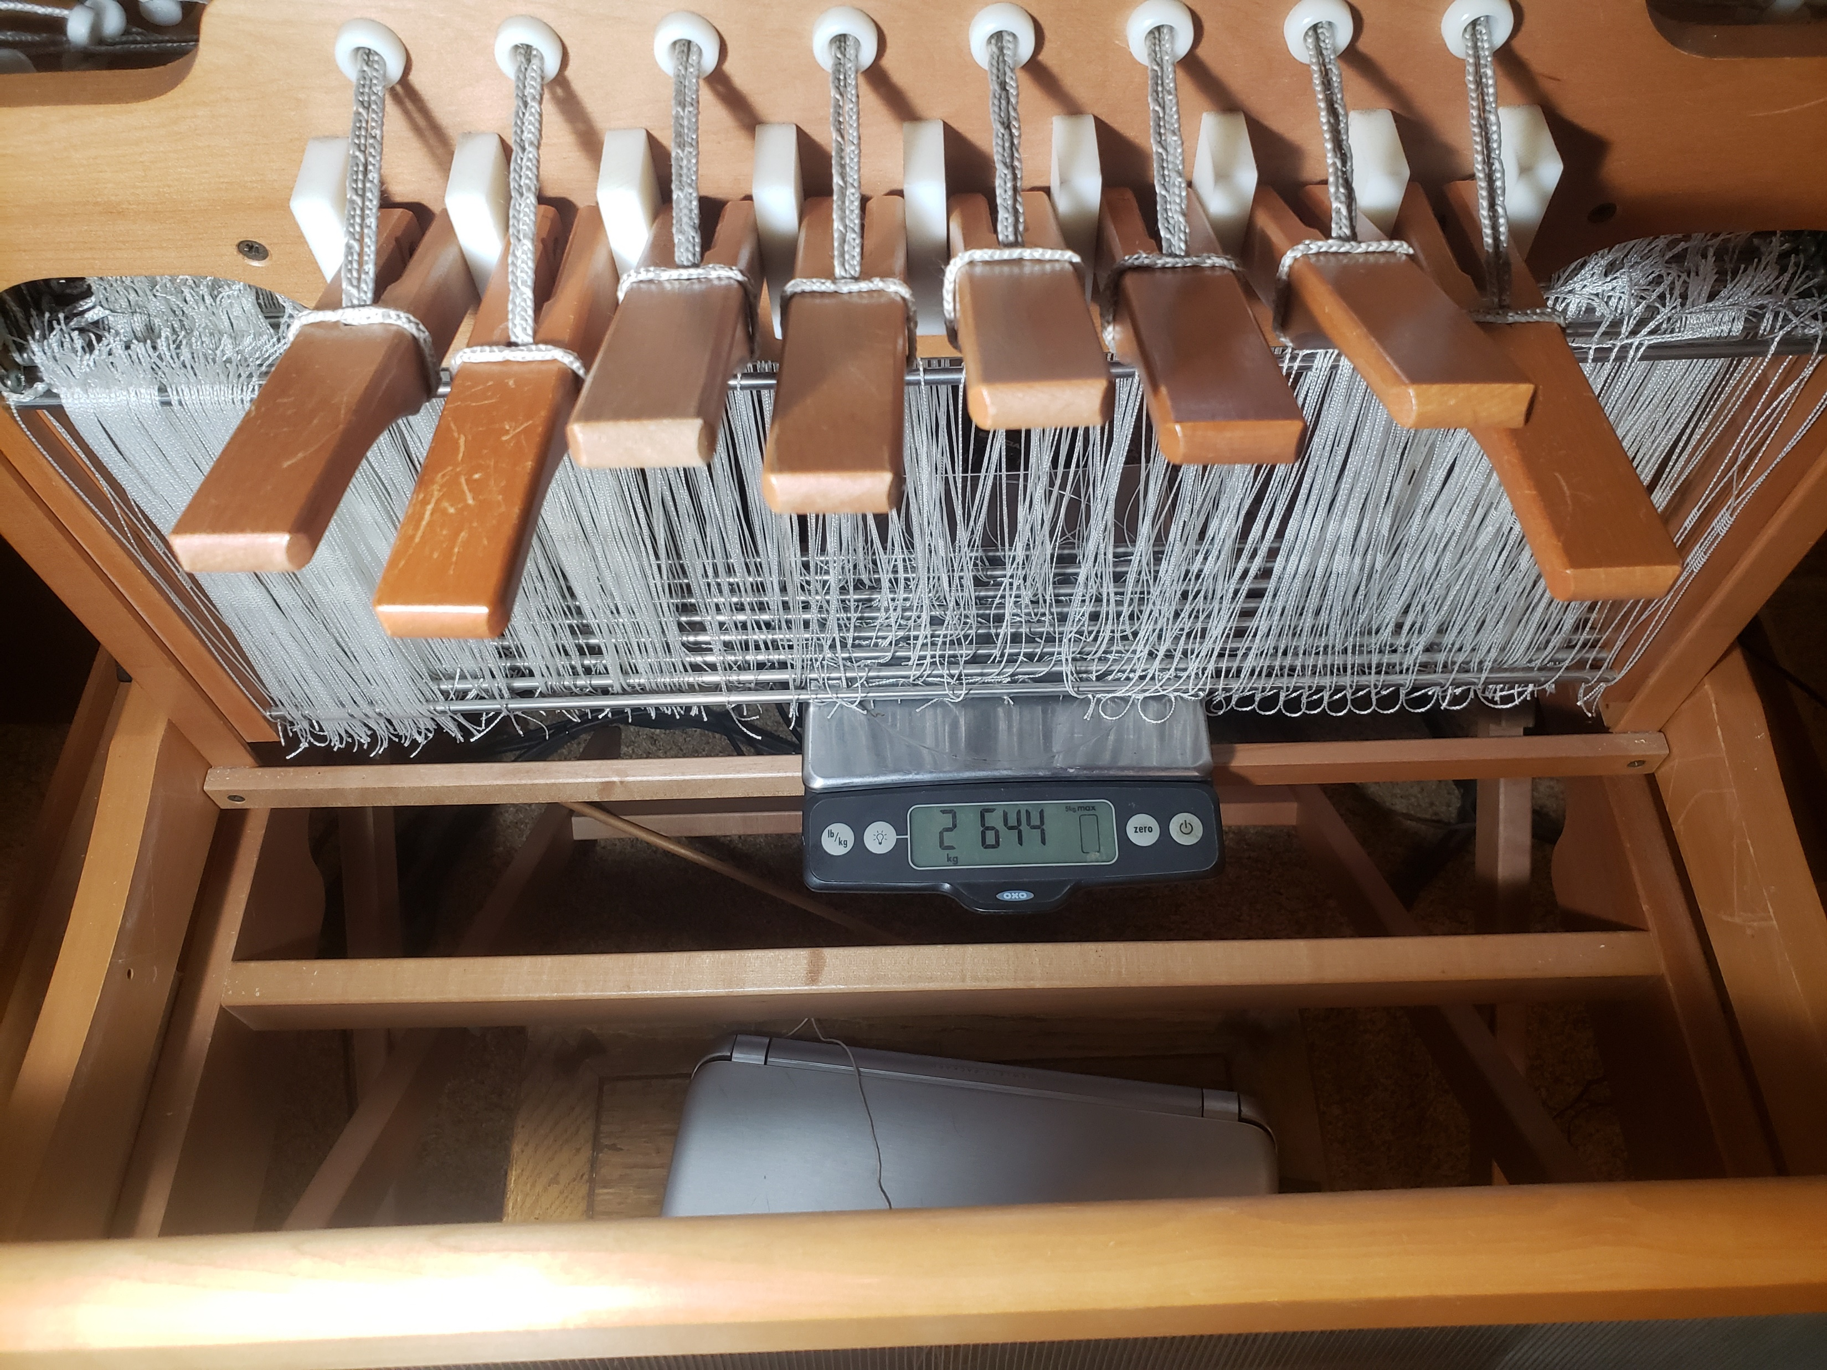
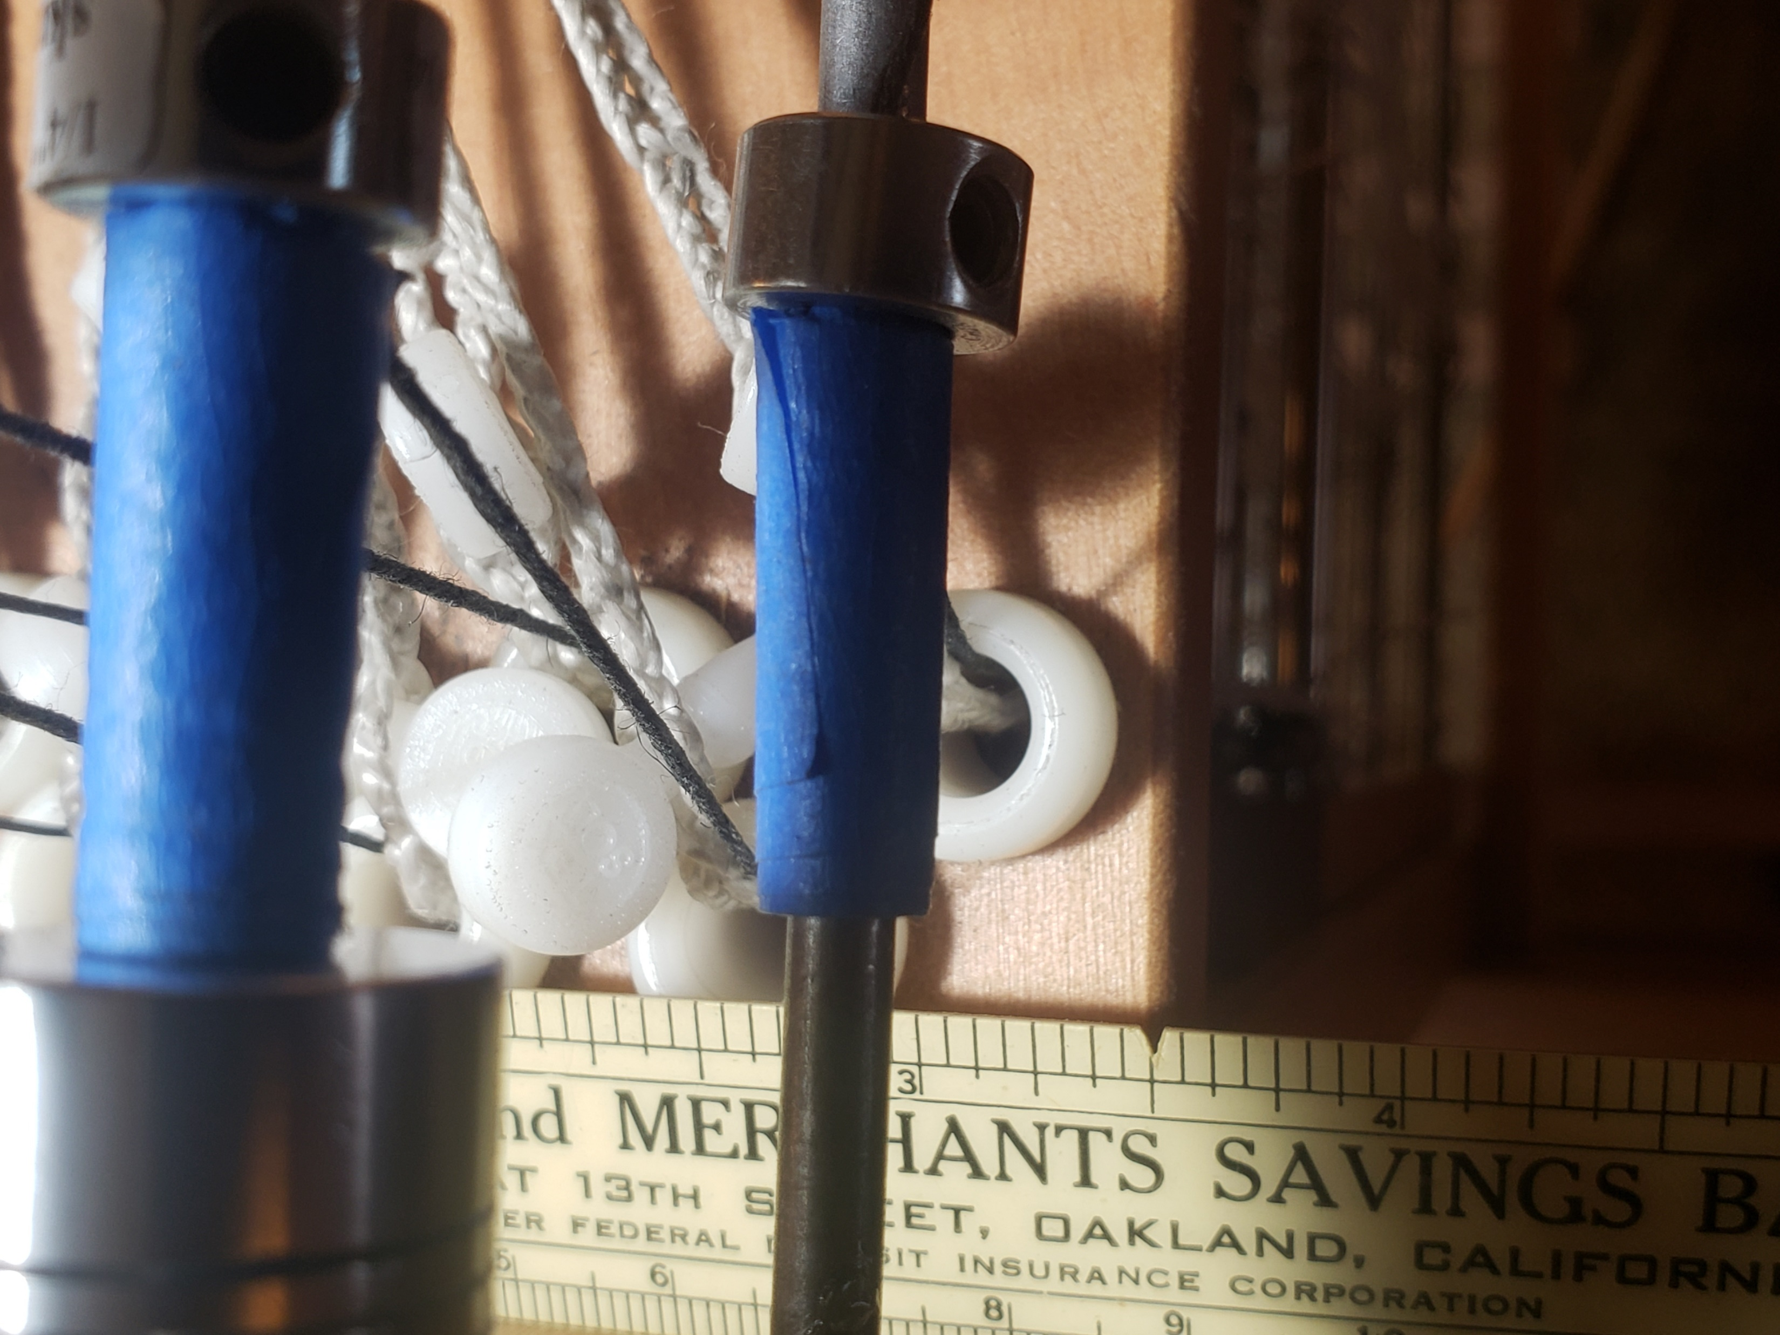
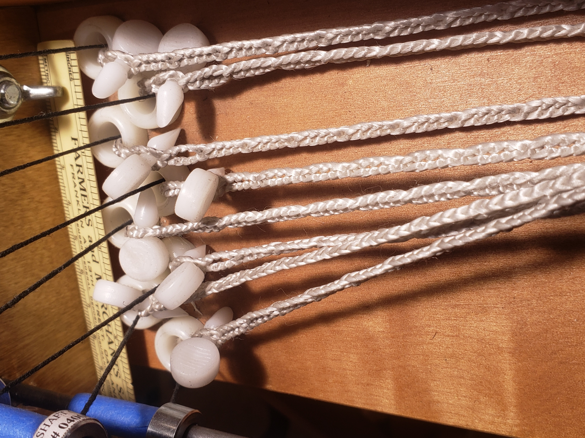
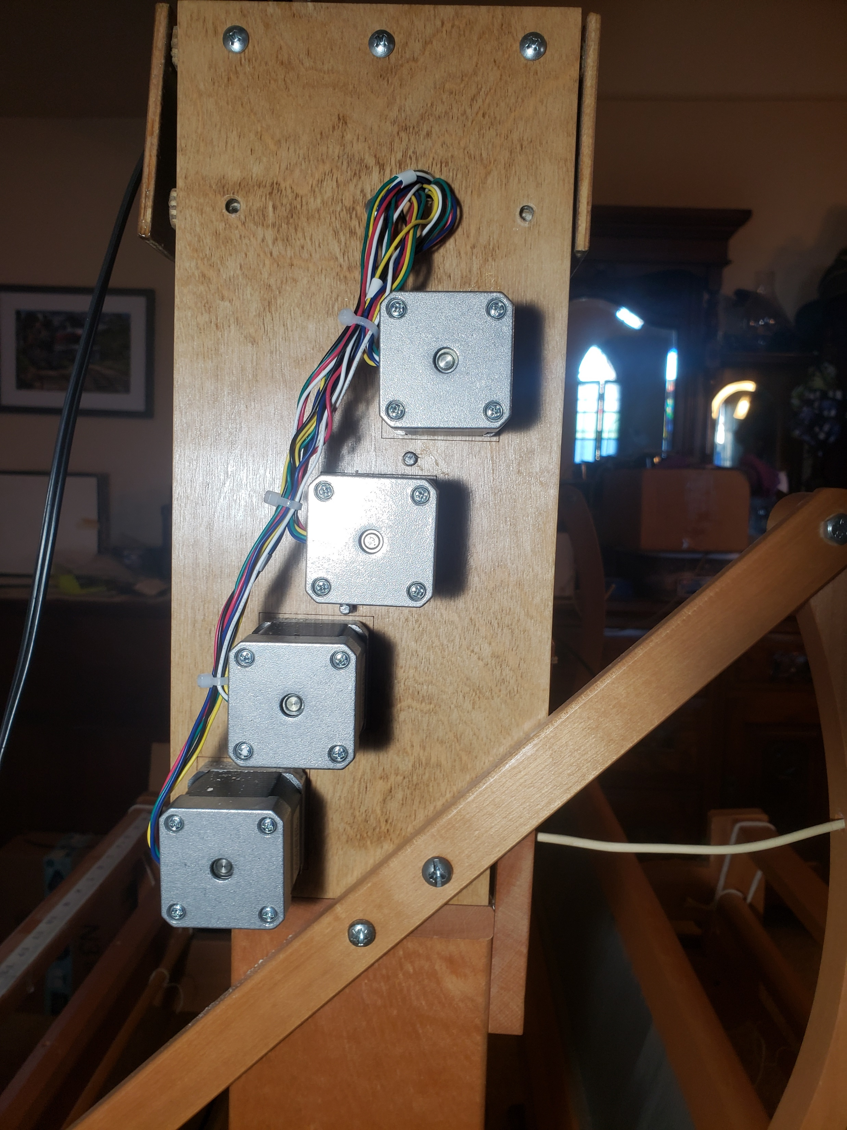
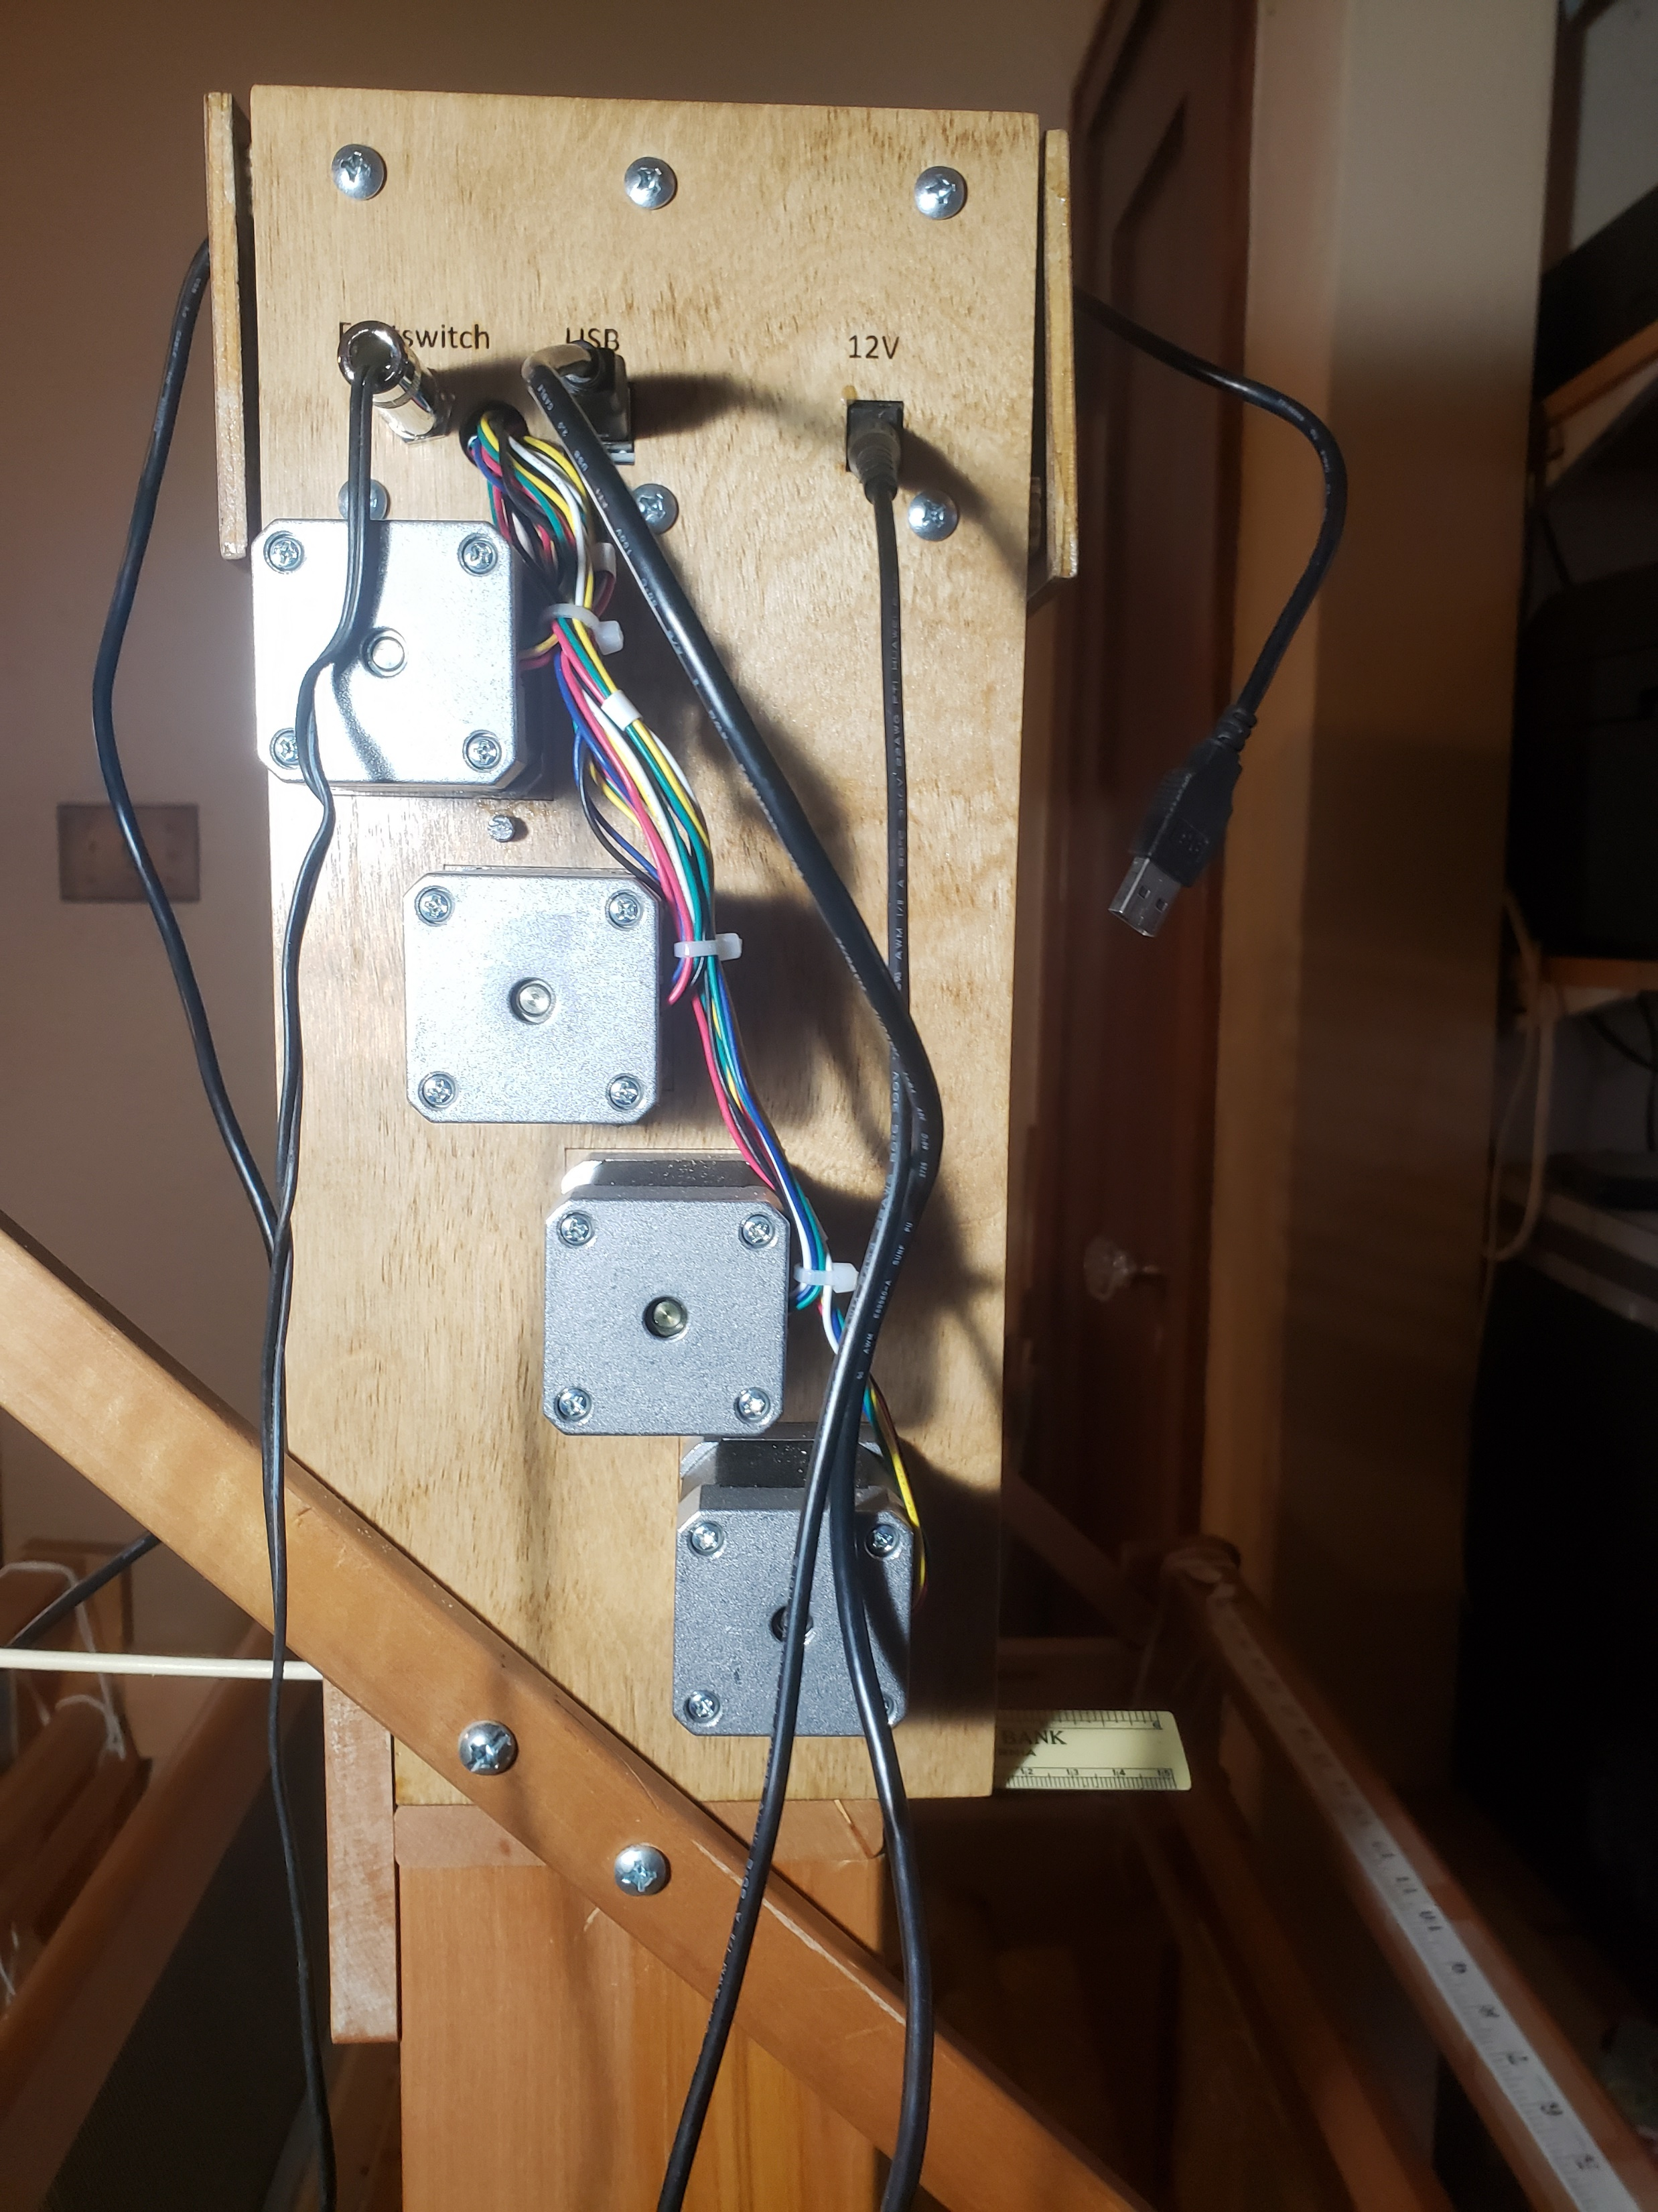
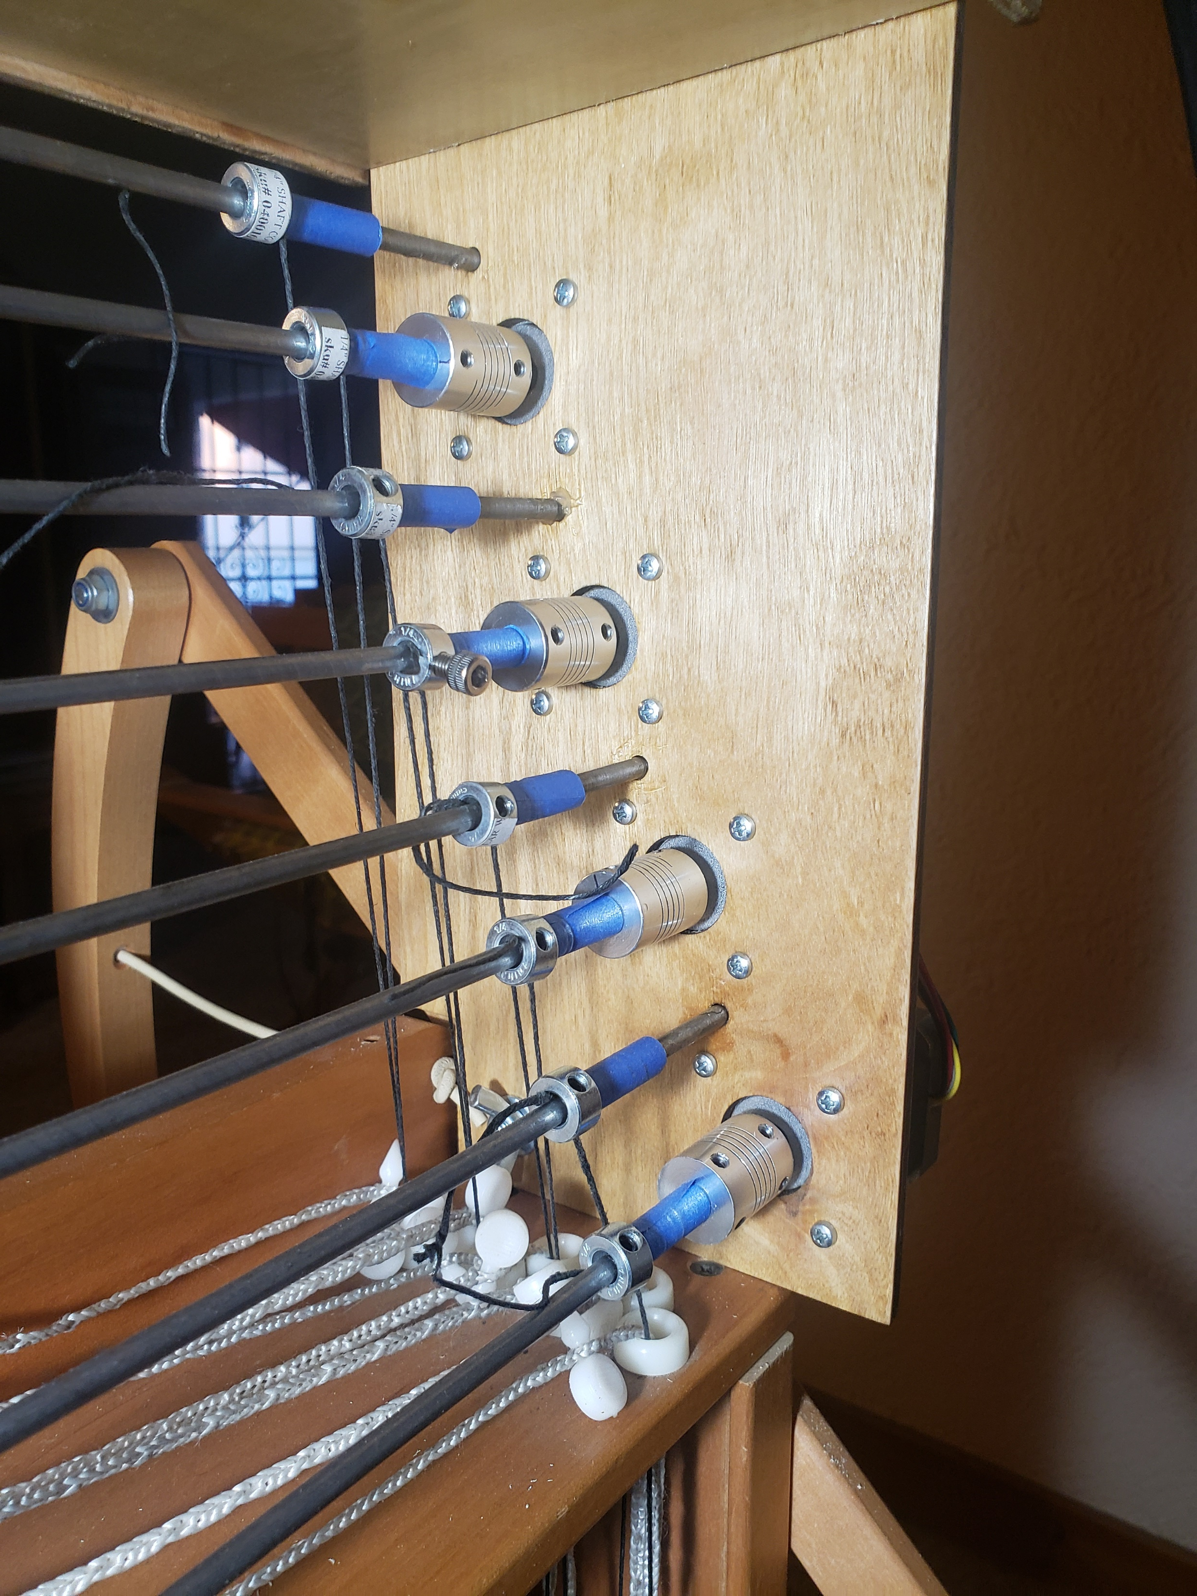
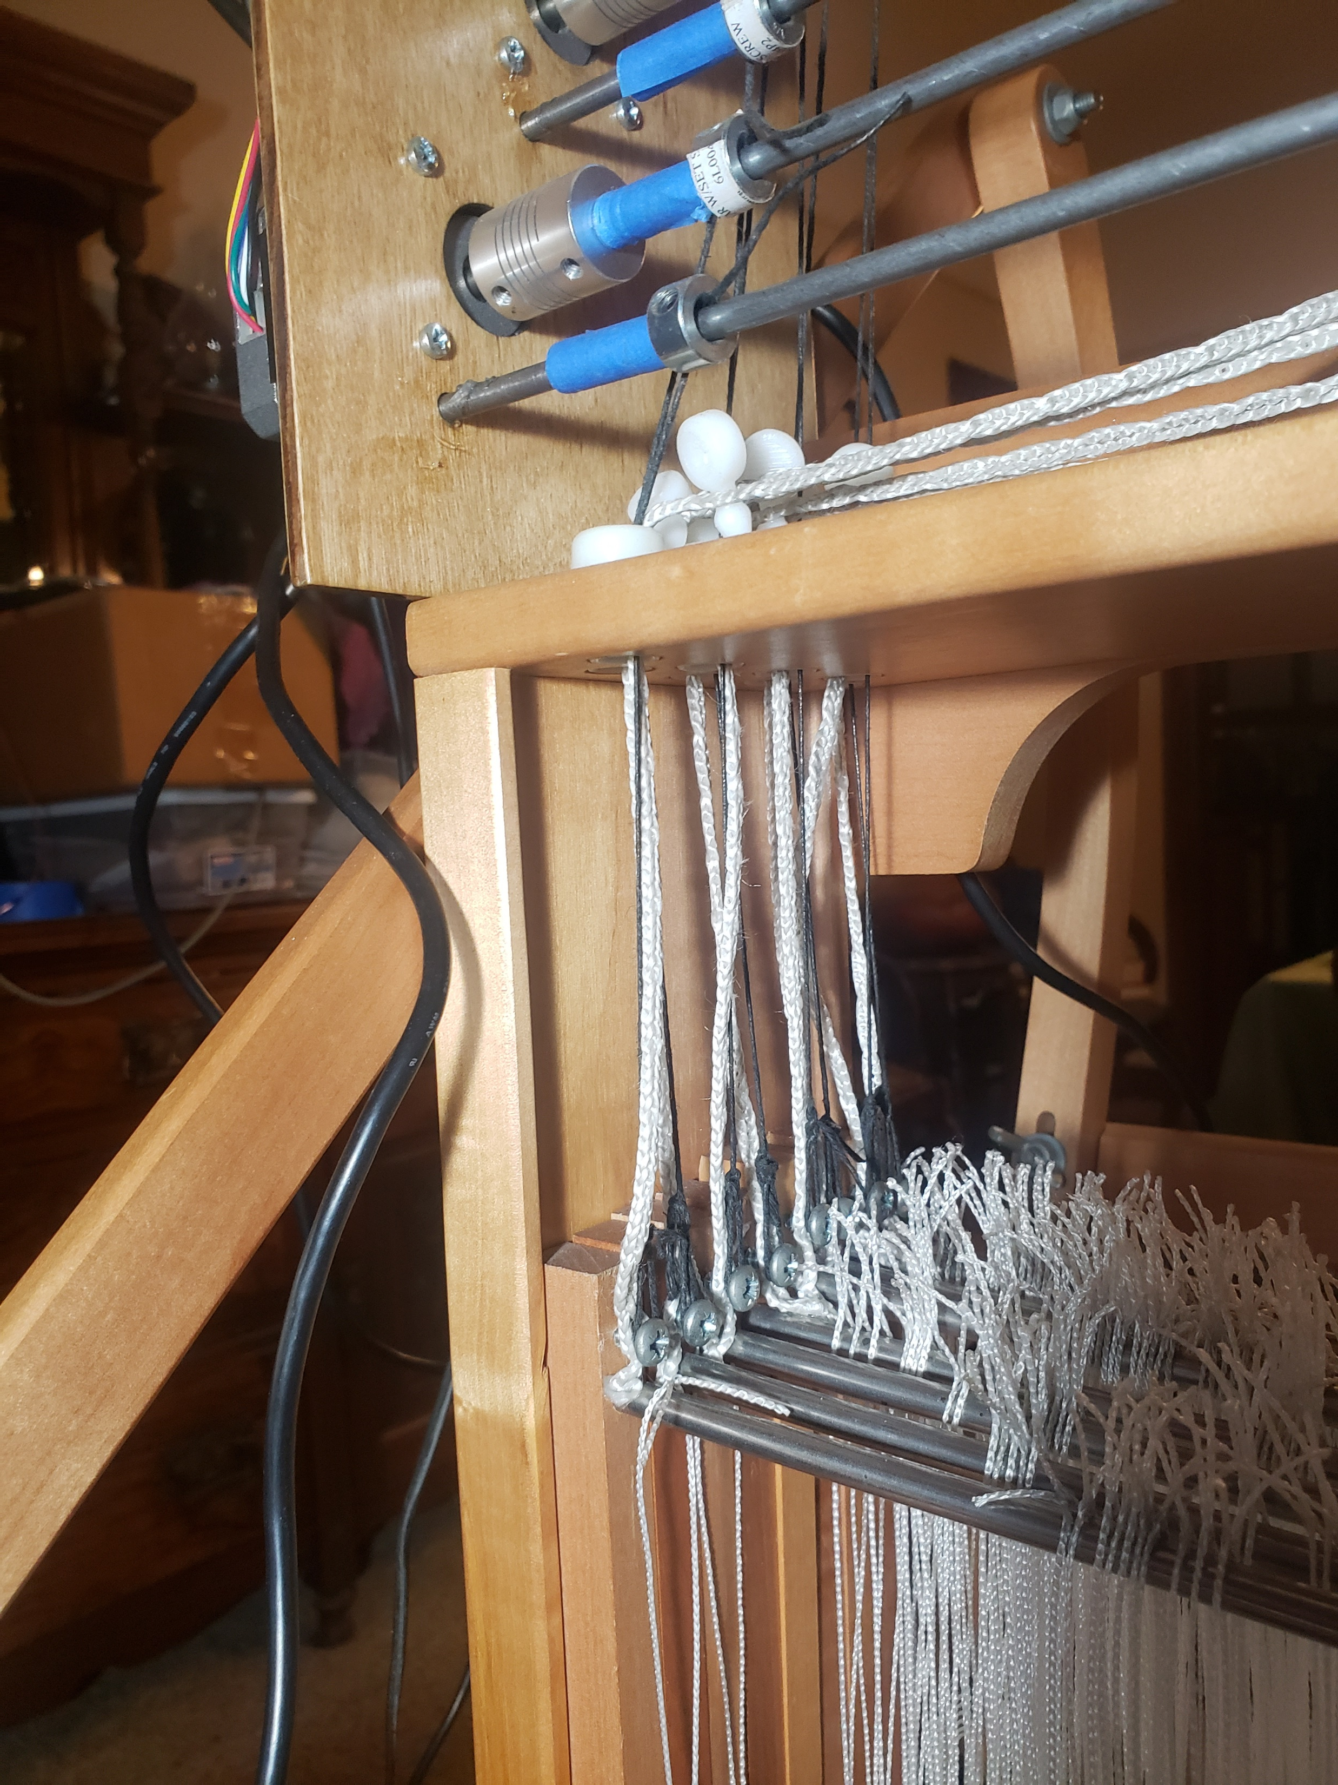
Total weight – 8 shafts
(Scale resting on lower rails of castle)
Lever arm to raise shafts: 5mm shaft
+ 12” tape to increase shaft diameter
Total width of 8 shafts ~3”
0.42” spacing between shafts
Blue tape on rods increases diameter, utilizing reserve torque in motors to reduce number of rotations (and time) required to lift shafts
¼” collars on 5/16” rod hold connecting thread to rod,
easy to adjust for length & position
Assembled Left Side
Shaft motors 2,4,6,8
Assembled Right Side
With power & USB connections
Shaft Motors 1,3,5,7
Interior Right Side
(Ends of Shaft Rods 1,3,5,7
In holes in right side)
Black threads connect Weaving
shafts to rod, Loop fits over screw head for ease of removal

Slide 4
Right
12V
USB
Footswitch

Slide 5
Left

