Slide 1
Using Low-cost Stepper Motors
To Create a Dobby Mechanism

Slide 2
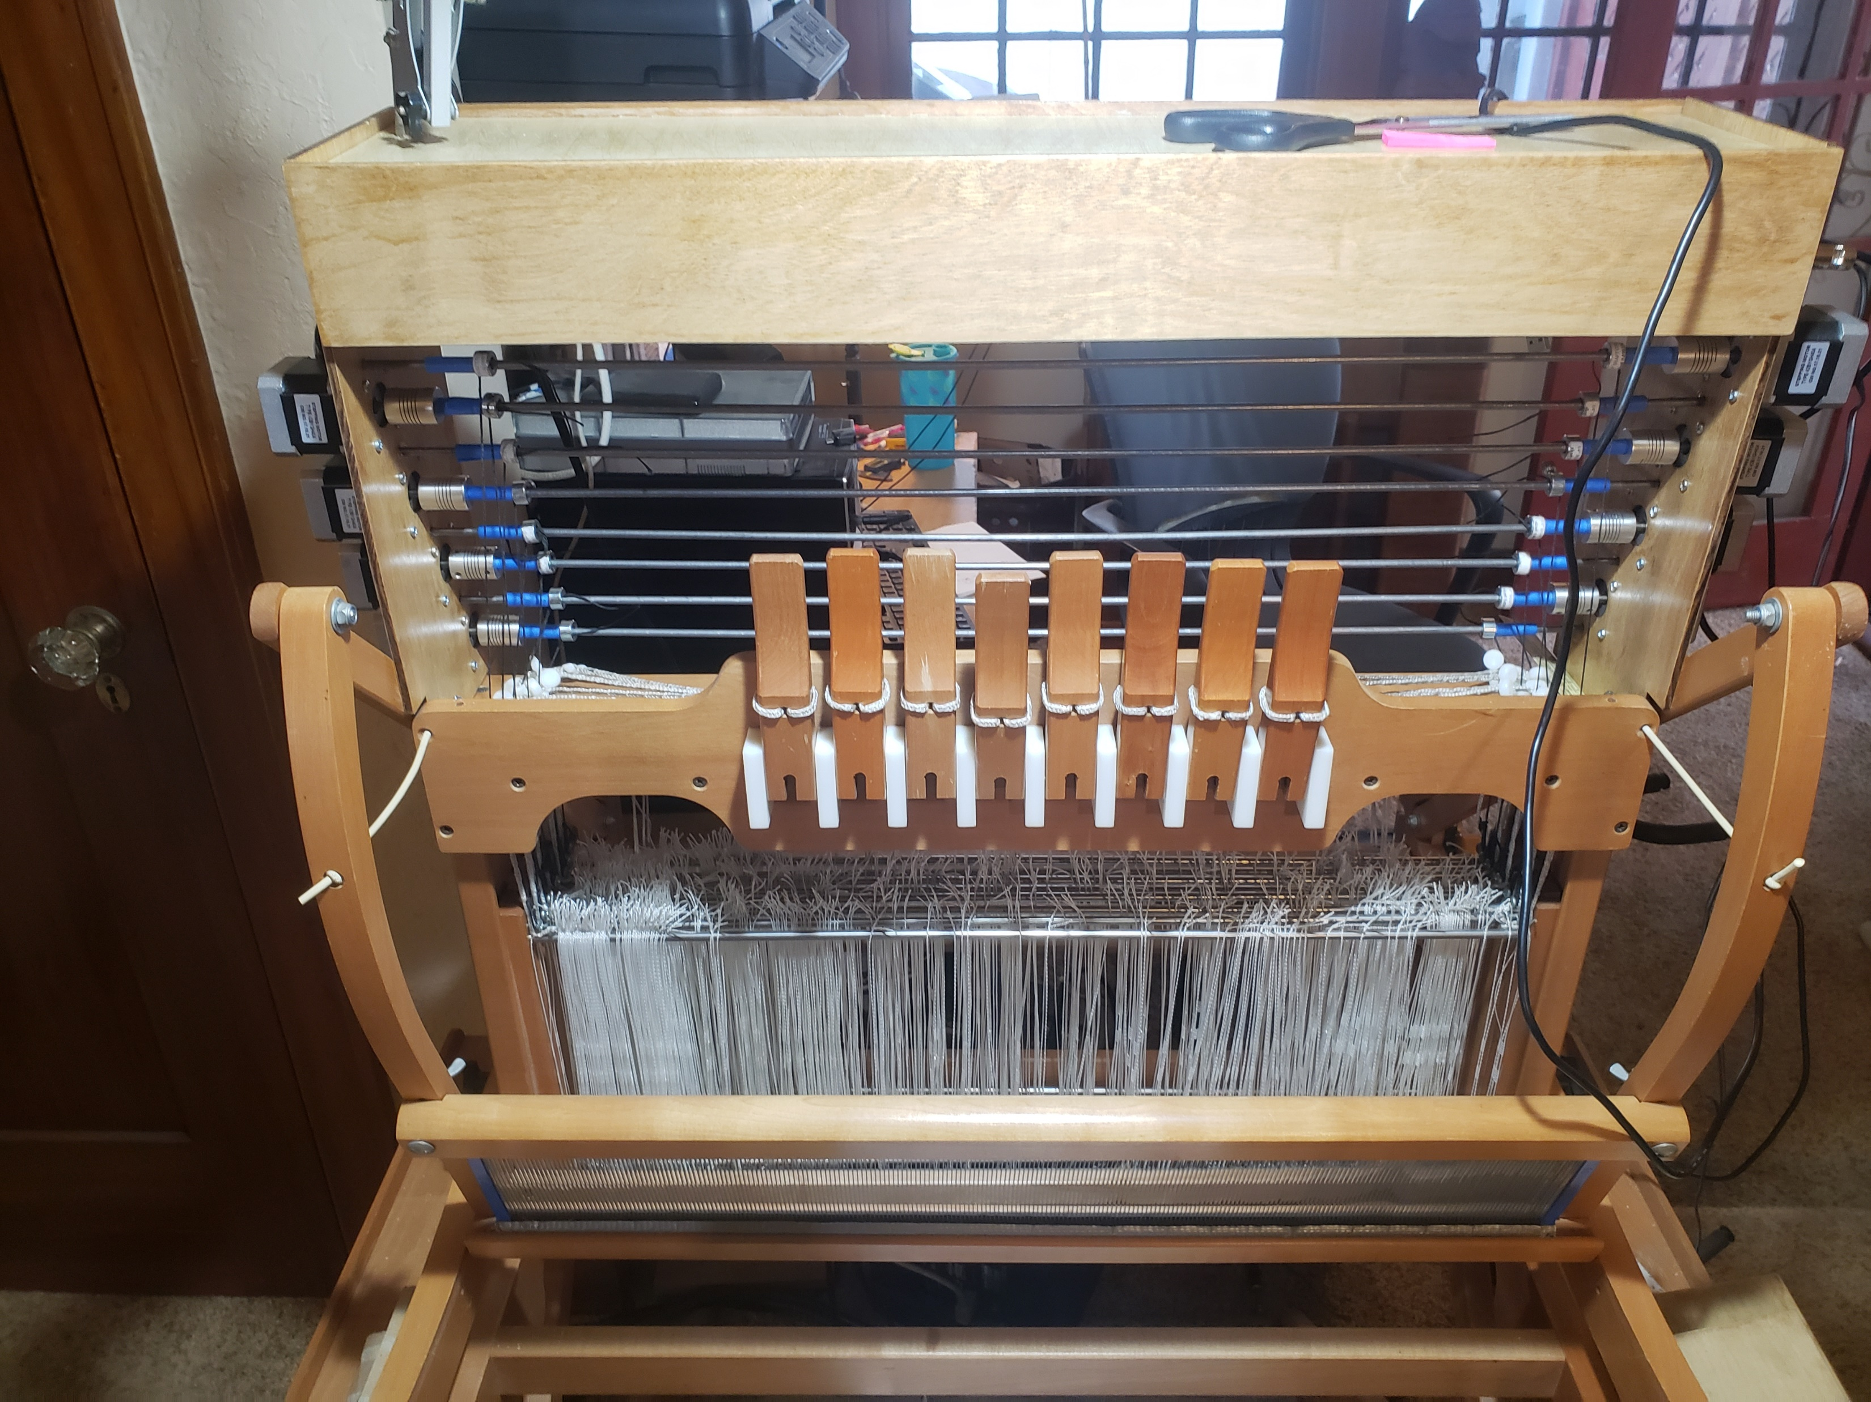
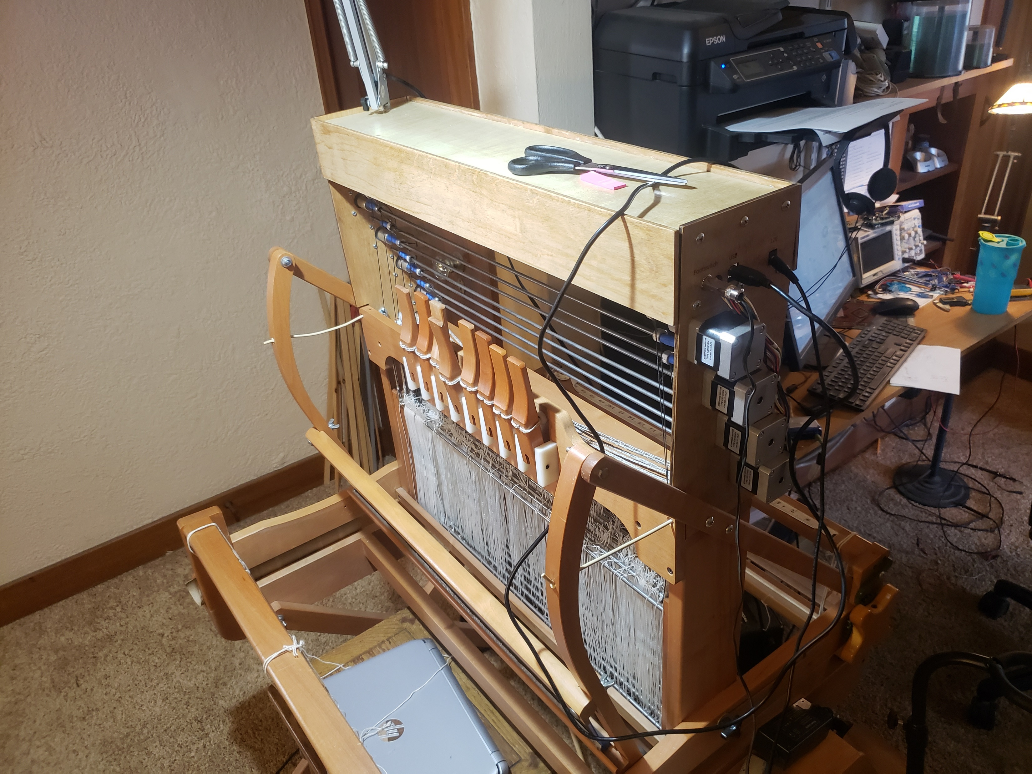
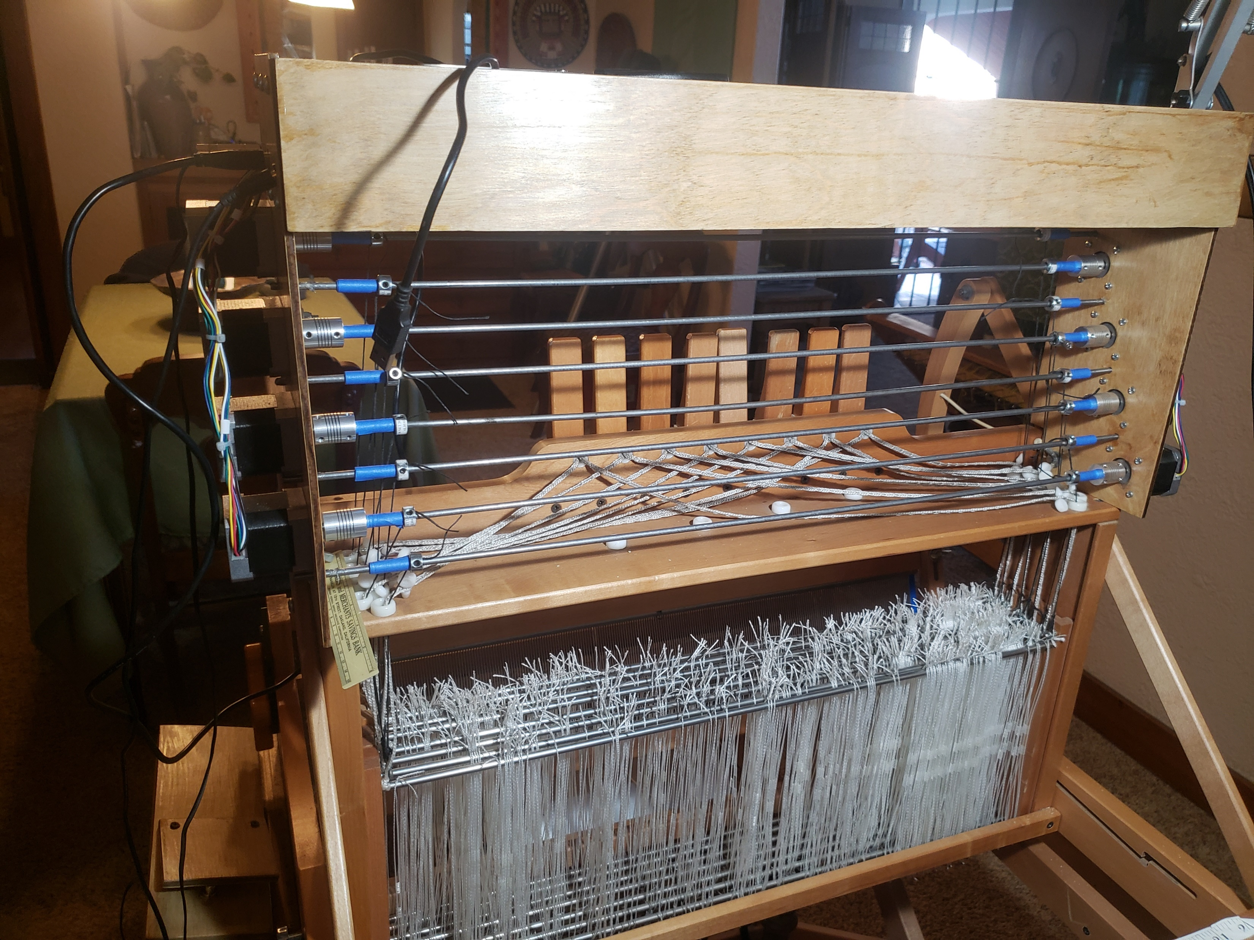
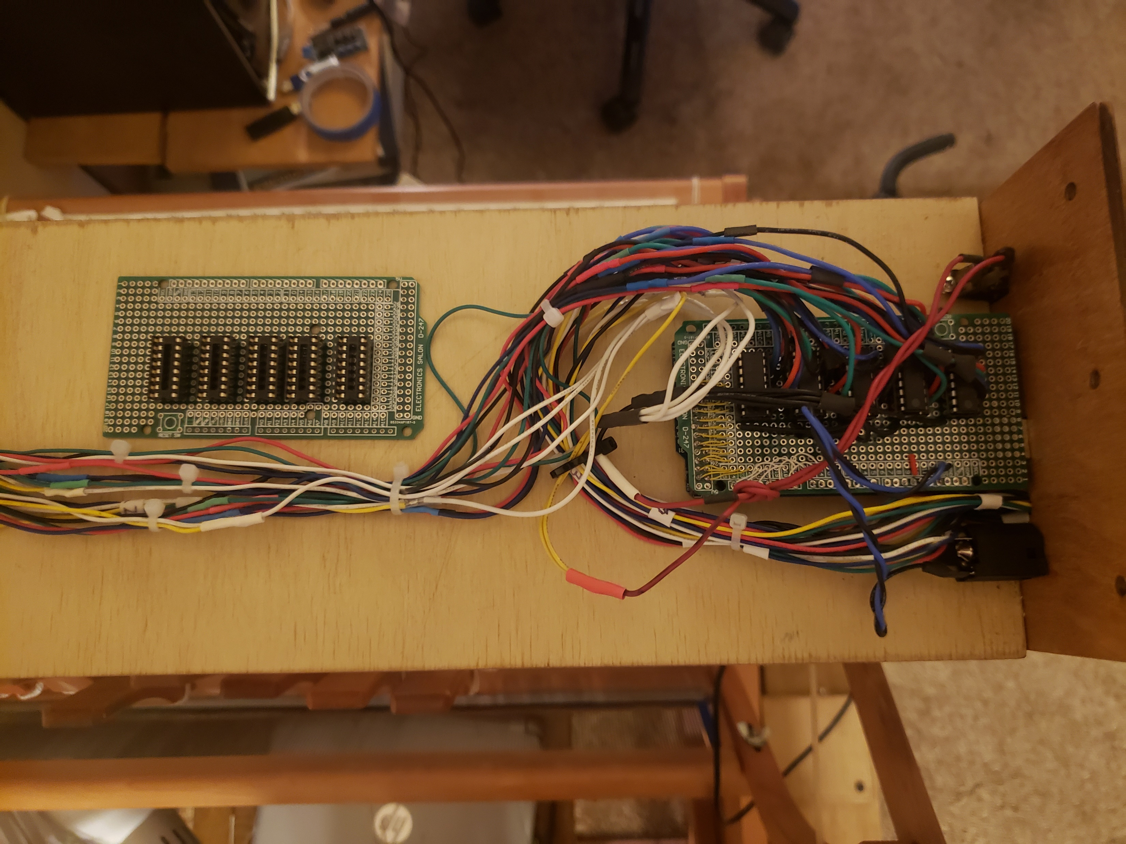
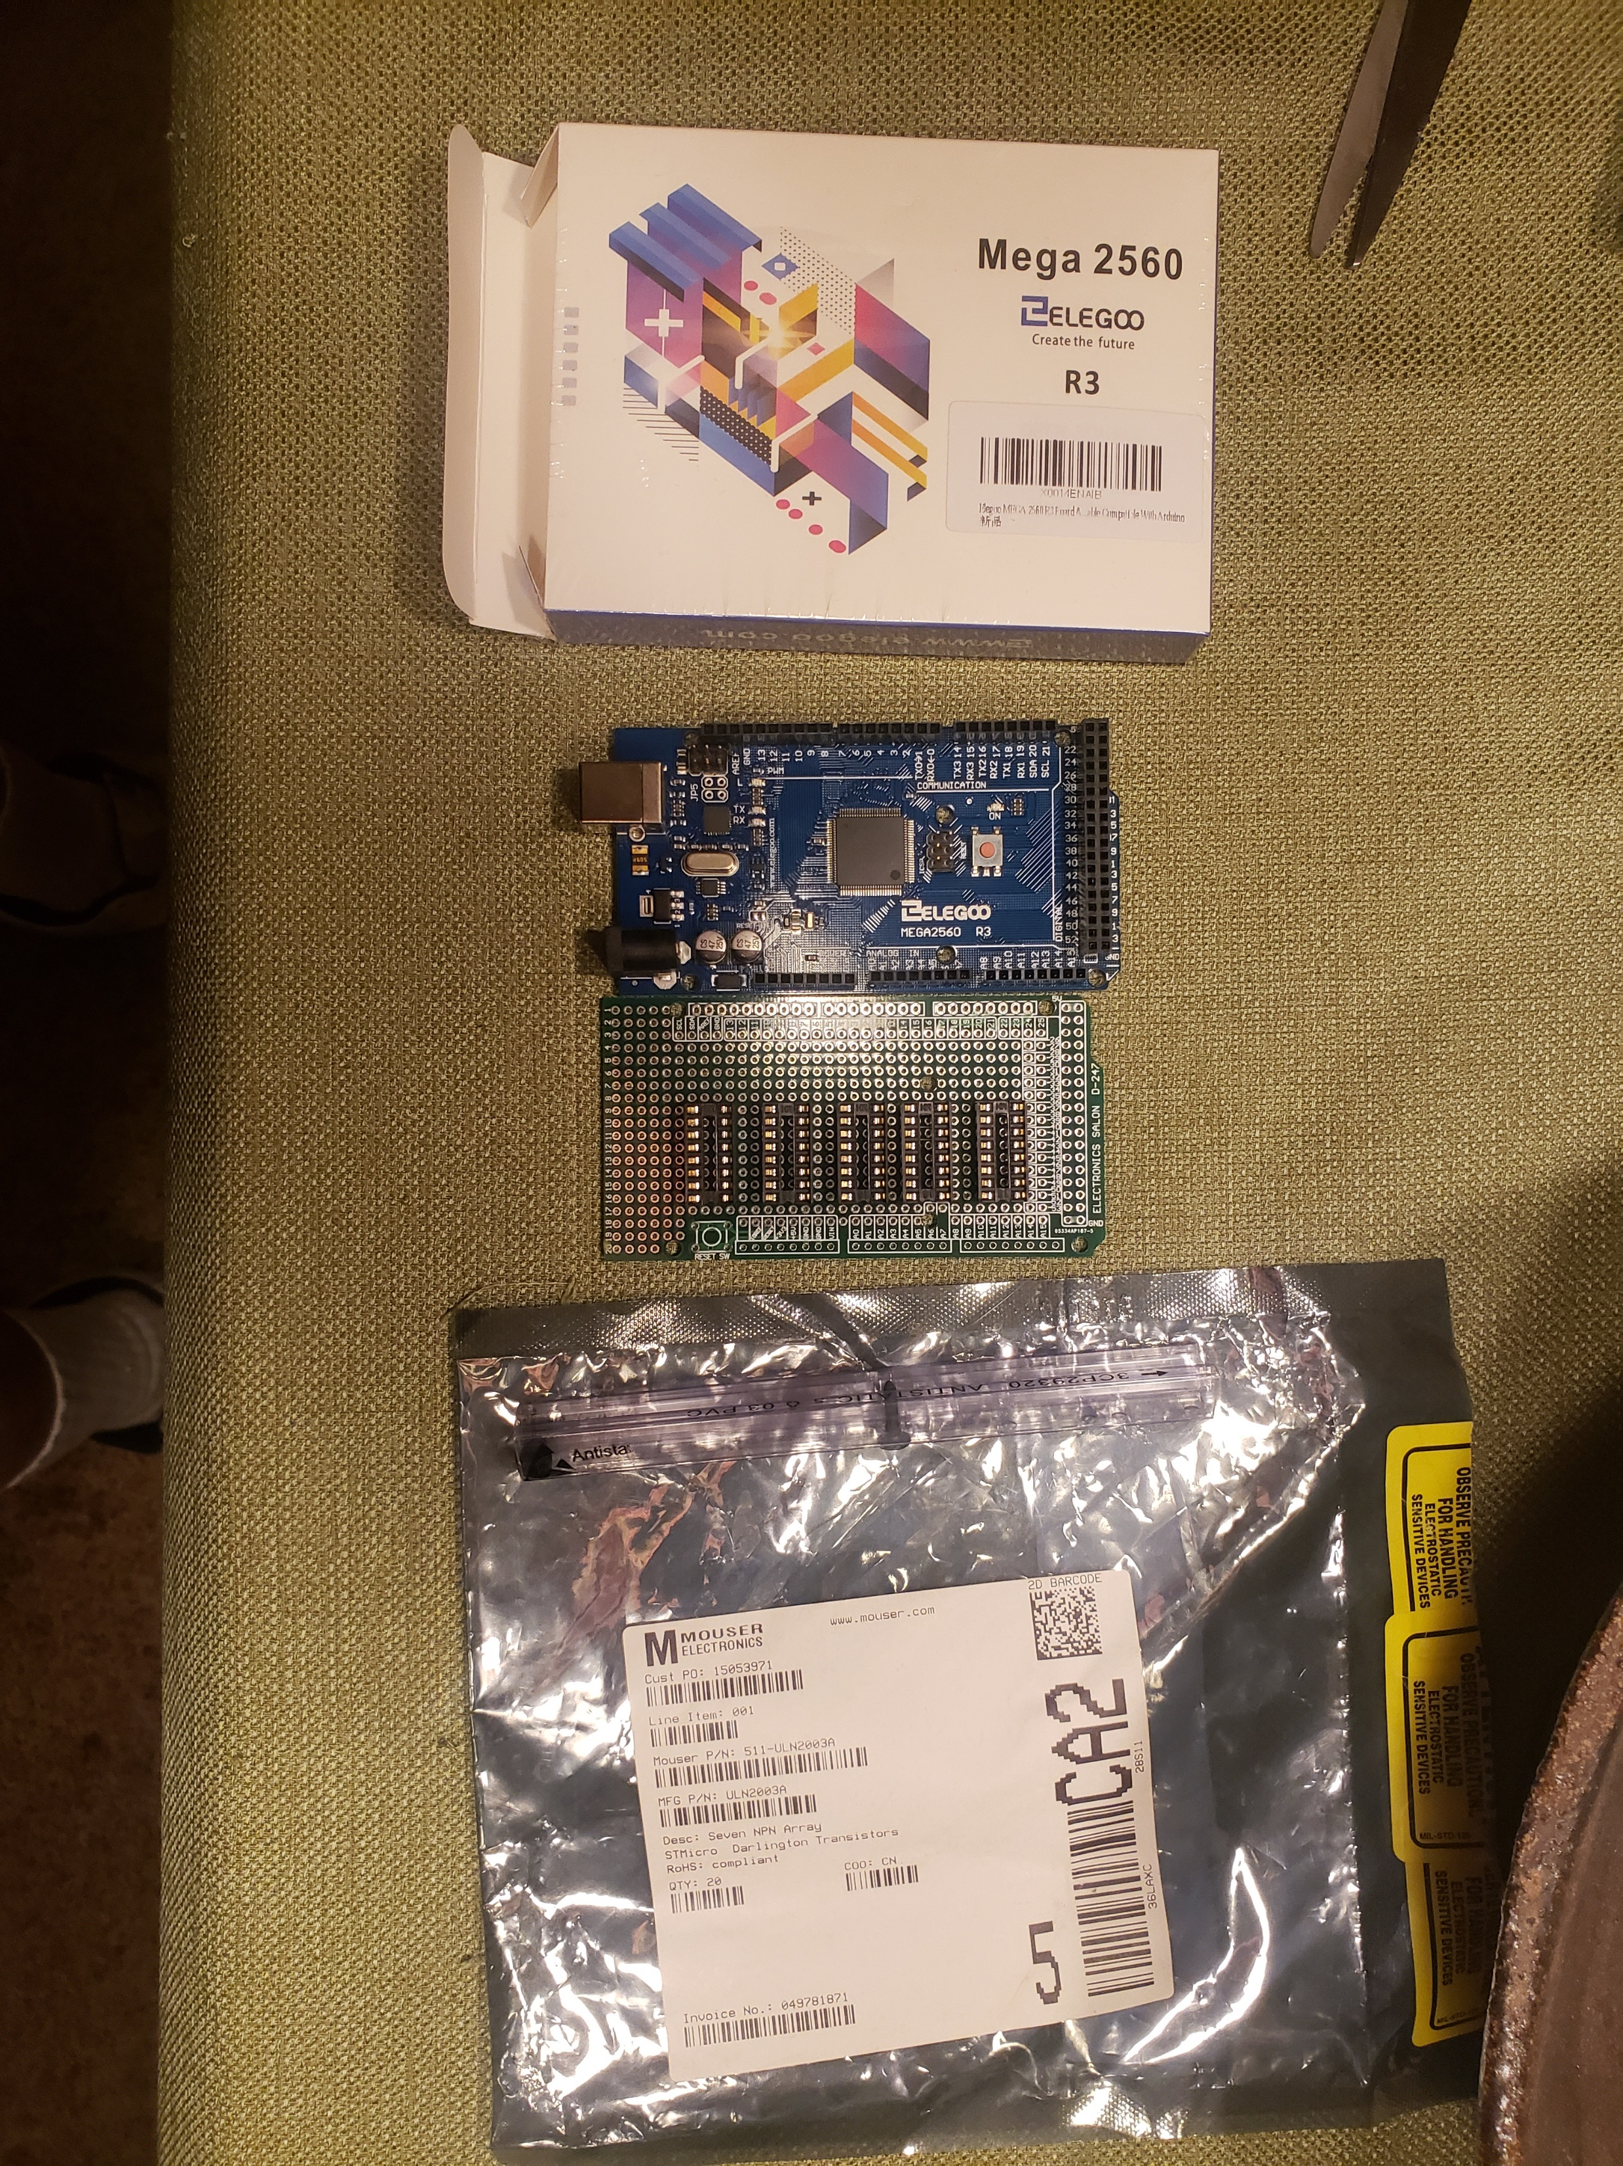
Front View
Right Side View
Back View
Electronics: Mega 2560 processor
Mega2560 prototyping shield
7 ULN2003A driver chips
Completed electronics assembly
(with prototyping shield showing layout of drivers)
{Housed inside top cover assembly}

